Slide 1
W3C Web of Things POC Planning – Intel Contributions
Michael McCool, Principal Engineer SSG/DPD/Technology Pathfinding and Innovation

Slide 2
Proof of Concept (POC) Development: Goals
Overcome a specific technical obstacle
Demonstrate business value of a new technology or standard
Advance engagements with key ecosystem players
Metadata bridges (value: increase adoption and applicability)
Support all existing IoT devices from multiple ecosystems
Voice control (value: demonstrate utility, engage key ecosystem player)
Support any IoT device with adaptive semantic voice controls
Fog Integration (value: develop support for ubiquitous localized services)
Deploy using local compute resources for proxies, translators, and applications
Notes:
After the above infrastructure is in place, we still want to schedule some POCs for “development systems” based around service composition.

Slide 3
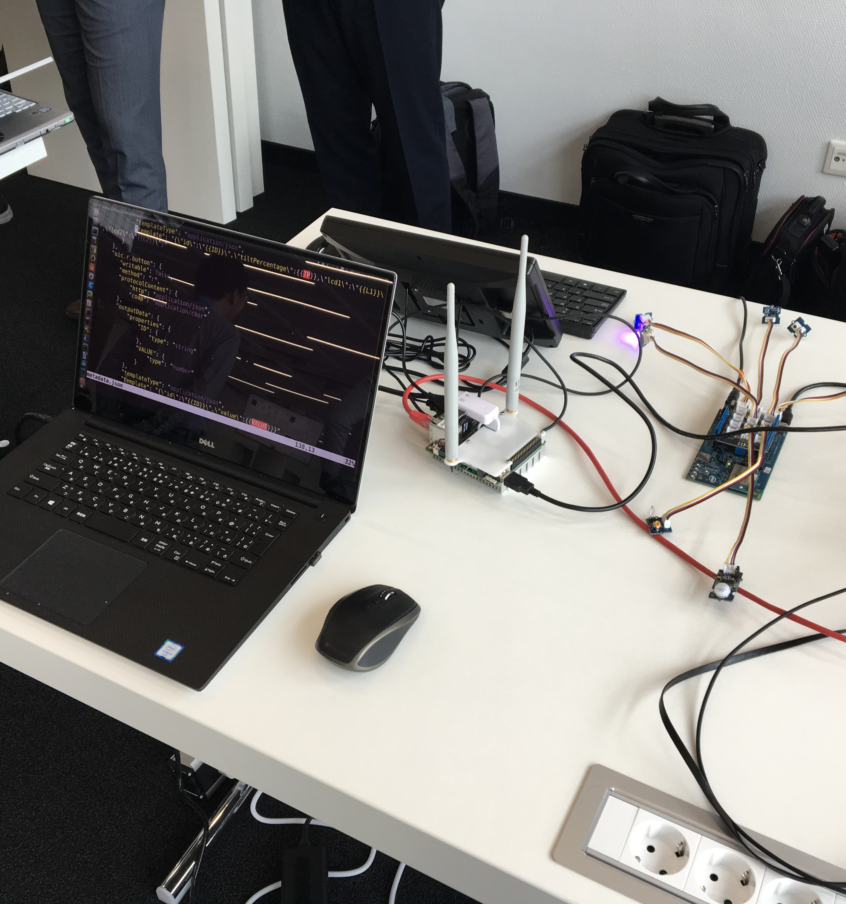
Metadata Bridge
Goal: Increase number of devices accessible via WoT standard
Read external metadata and translate into WoT TDs
Infer and add extra information not available in native metadata
Make IoT devices available to any system that can process WoT TDs
Does not need specific changes to target IoT devices.
→ Prototype built using OCF Smart Home Demo as test target.

Slide 4
Metadata Bridge Dusseldorf WoT Plugfest, July 2017
Goal: Translate OCF metadata and make it available to via WoT Thing Description
Gateway (UP Squared)
Controller (Laptop)
Auxiliary
Metadata
HTTP bridge
WoT Test
Servient
OCF
metadata bridge
Docker Container
Leaf Processor (Edison)
OCF
proximity
OCF
temp
OCF
light
OCF
button
OCF
proximity
OCF
temp
OCF
light
OCF
button
Simulated Hardware
Physical Hardware

Slide 5
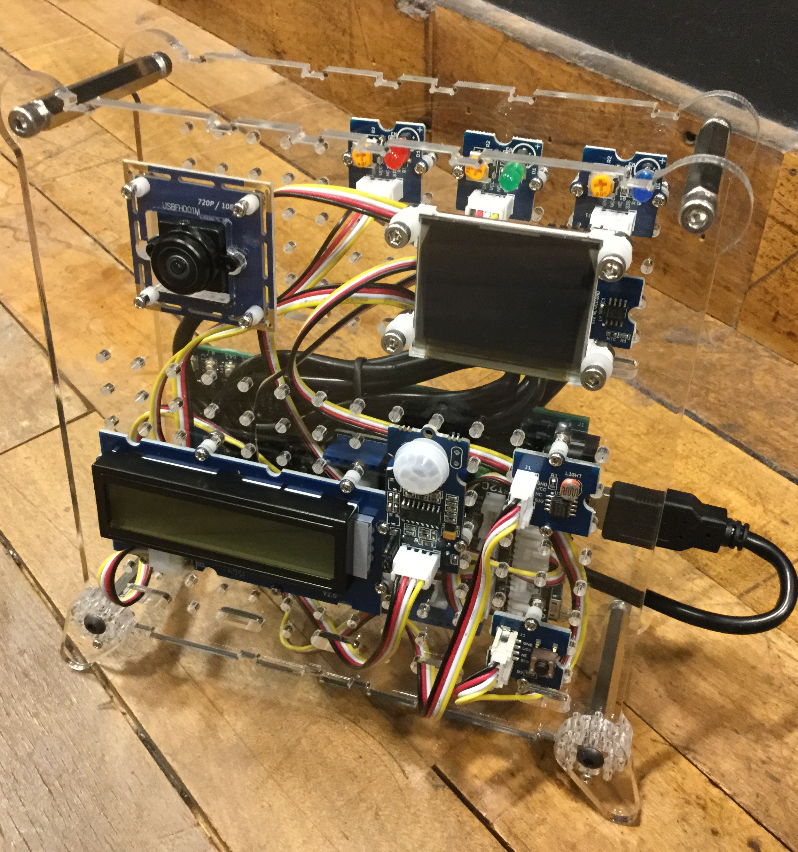
System Integration
Goal: Improve and Expand System Architecture
Support NAT traversal, Thing Directory, Proxies, and Shadows
Support CoAP
Support OCF native metadata more completely
Support non-OCF devices and services
Support secure transport and authentication

Slide 6
System Integration Burlingame WoT Plugfest, July 2017
Add: Ingest official OCF data models, traverse NAT, use Thing Directory, CoAP
Gateway
RAML OCF
Metadata
Cloud
NAT
OCF
metadata bridge
Thing Directory
Auxiliary
Metadata
Web Dashboard
WoT Proxy
Servient(s)
WoT Application
Servient
WoT Shadow
Servient(s)
HTTP bridge (optional)
Docker Container
Leaf Processor (Edison)
OCF
proximity
OCF
temp
OCF
light
OCF
button
OCF
proximity
OCF
temp
OCF
light
OCF
button
Simulated Hardware
Physical Hardware

Slide 7
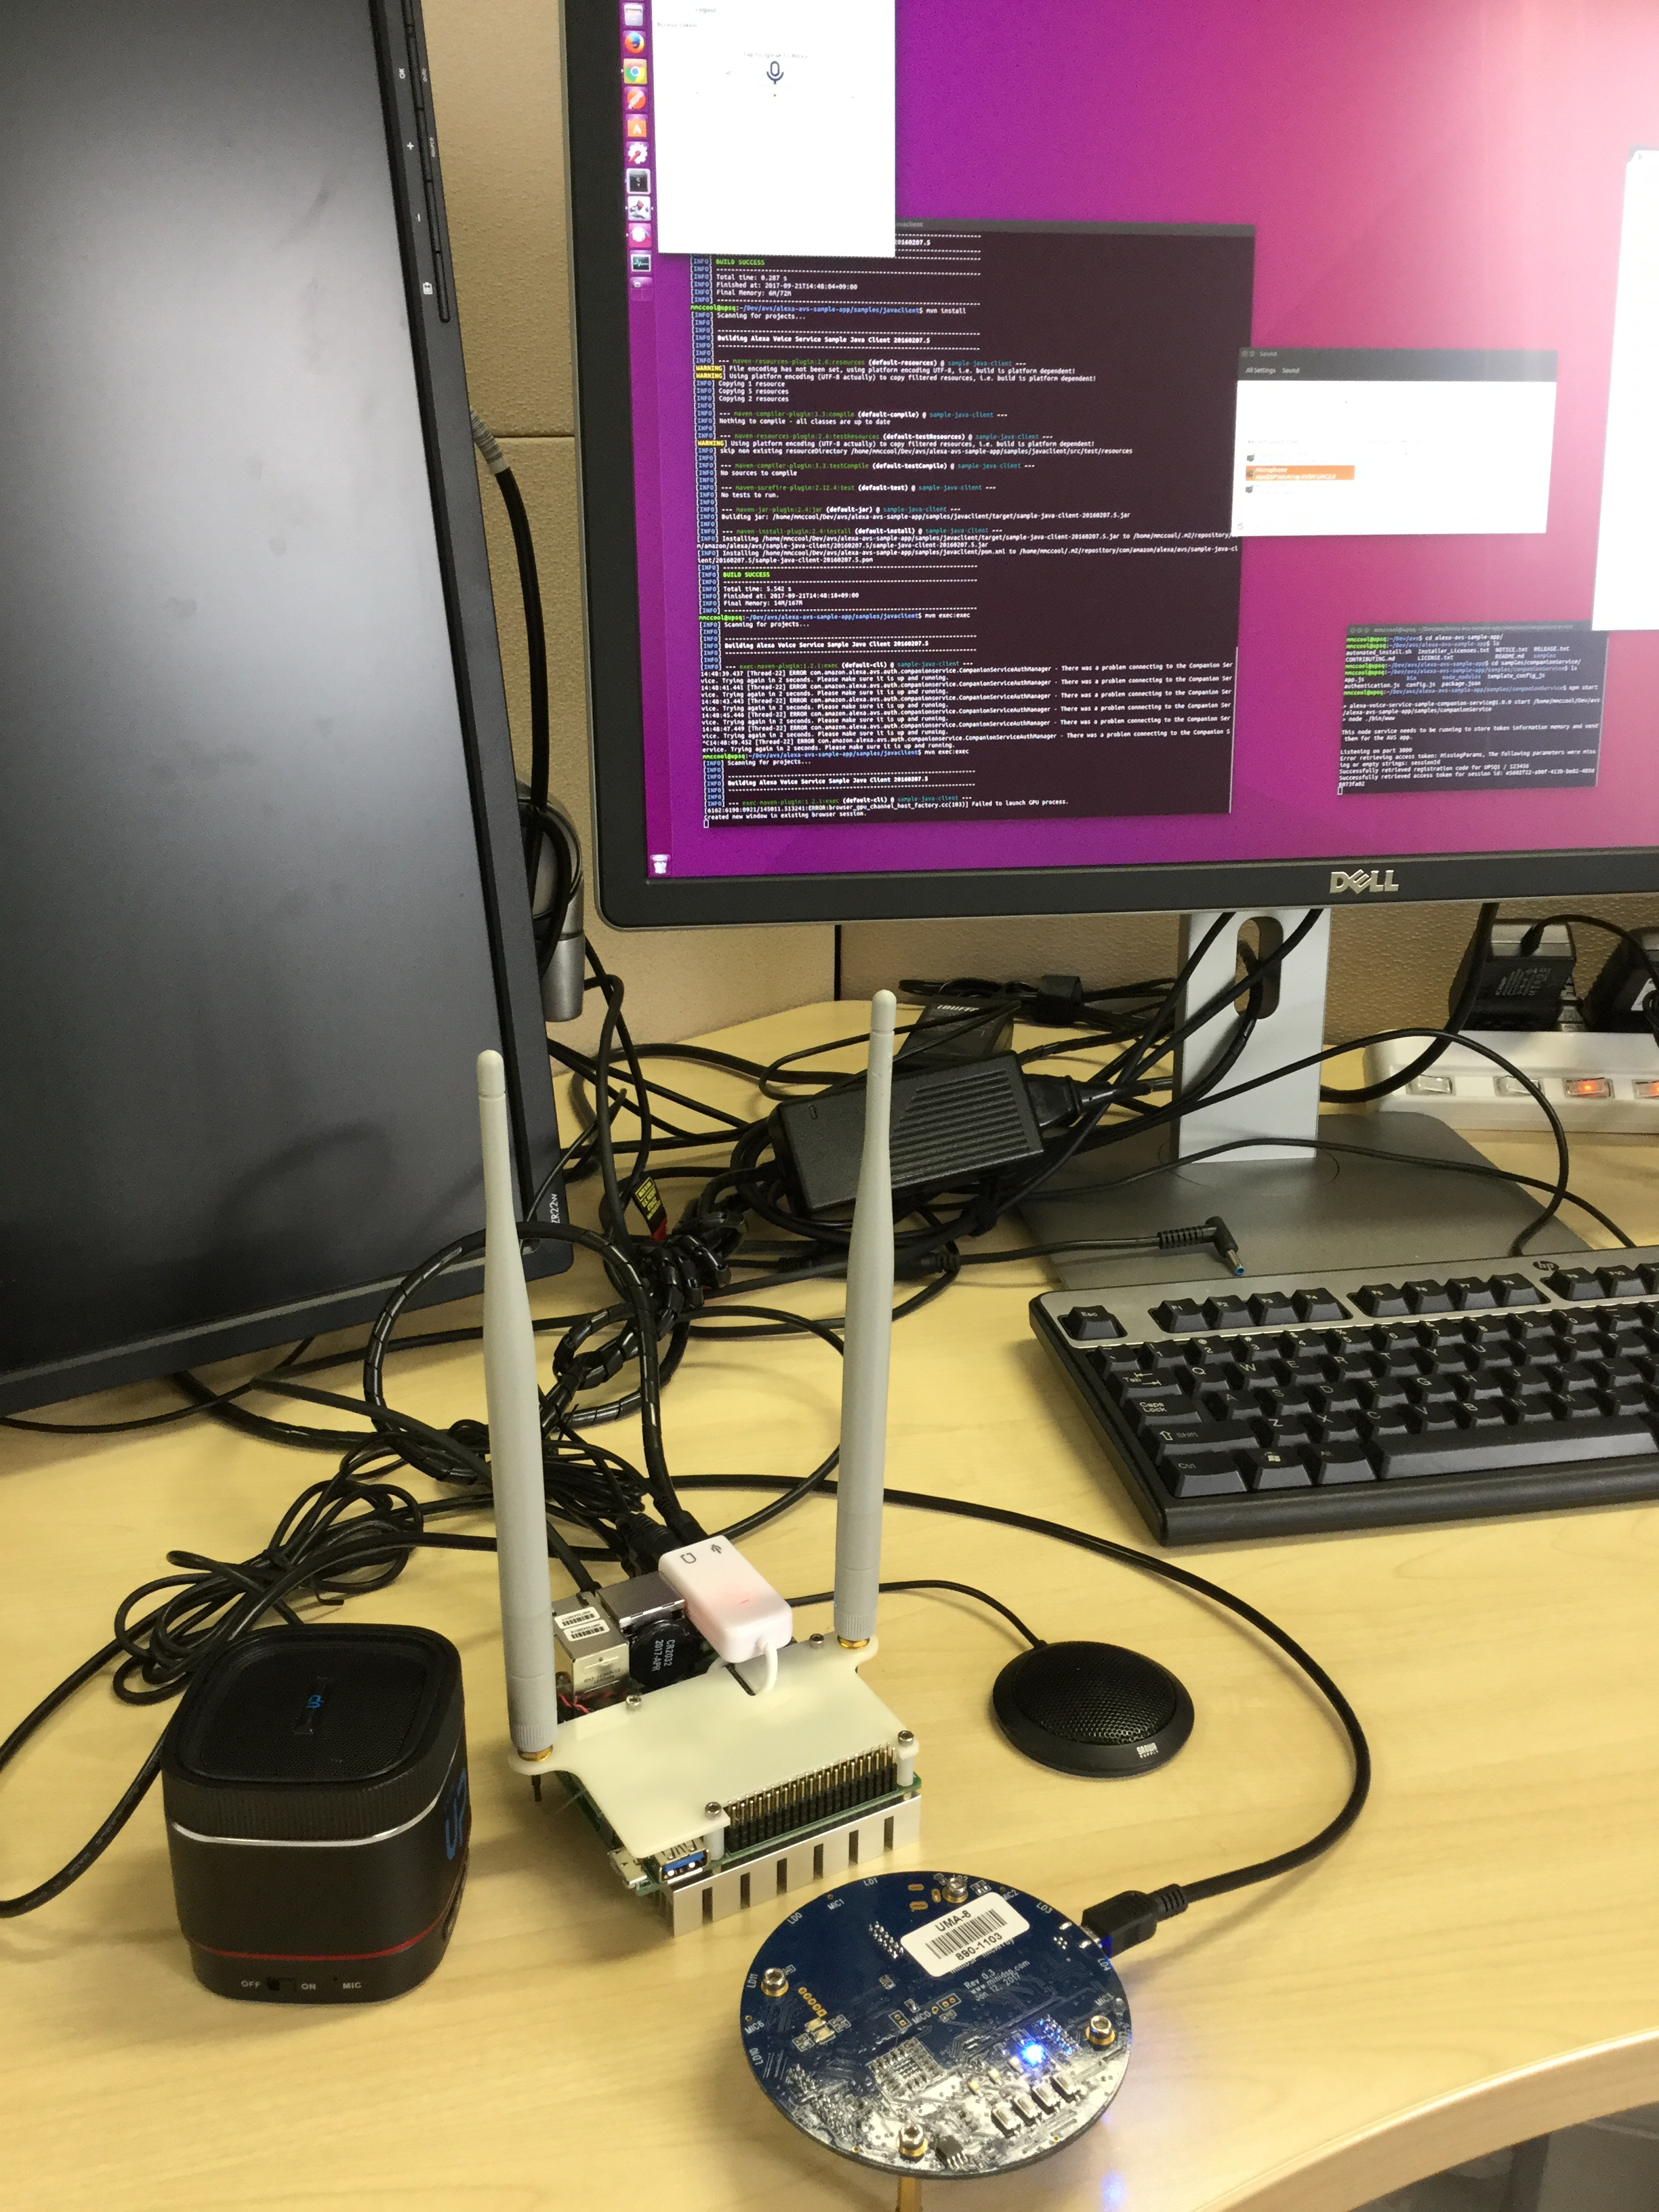
Voice Control
Goal: Enable automatic voice control of any WoT-enabled device
Demonstrate use of semantic markup of Thing Description
Using iot.schema.org and SSNO ontologies and semantic inferencing tools
Generate adaptive AVS Alexa skill, bridging with Alexa Home Skill
Layer with WoT metadata bridges to control devices from multiple ecosystems (including OCF)
Notes:
AVS is picked as a concrete target, although the same approach could be used for Google Voice, Microsoft Cortana, etc.

Slide 8
Voice Control Burlingame WoT Plugfest, July 2017
Goal: Provide generic voice interface using WoT Thing Descriptions
Cloud
NAT
Gateway
AVS Server
5
Shadow
Factory
1
2
WoT Alexa Home Skill Adapter
Proxy
Servient(s)
AVS Client
3
Thing Directory
4
6
Shadow
Servient(s)
Far Field Microphone
Proxy requests Factory to make Shadow
Factory creates Shadow and registers it with Directory
Proxy opens websocket connection with Shadow
Alexa skill queries Directory to find Things during Discovery
AVS Client invokes skill via ASR and Home Skill Adapter
Intent is mapped to an appropriate Action on Shadow
Local IoT
Device
Local IoT
Device
Local IoT
Device

Slide 9
Alexa Smart Home Skill API - Summary
Assumes devices controlled by “device cloud”: a web service with a public URL.
Supports set of standard, built-in “intents” with predefined semantics
When understands one of these intents, creates a “directive” which is sent to an “adapter”, which is typically an AWS lambda function. Lambda is called for discovery first, then later with directives.
Directive contains: customer authentication, device identifier, and an action-specific payload.
Adapter should check the authentication (OAuth2.0), then send the payload to the specified device via the device cloud. The “device identifier” includes uuid and cookies provided during discovery.
Respond with an event that indicates success or failure. Can be synchronous (from the lambda) or asynchronous (from the device cloud).
Devices can also have shadowed status information and this can be proactively updated.
→ Note that all interactions MUST complete within 8 seconds, and ideally 5 seconds.
For details, see https://developer.amazon.com/docs/smarthome/understand-the-smart-home-skill-api.html

Slide 10
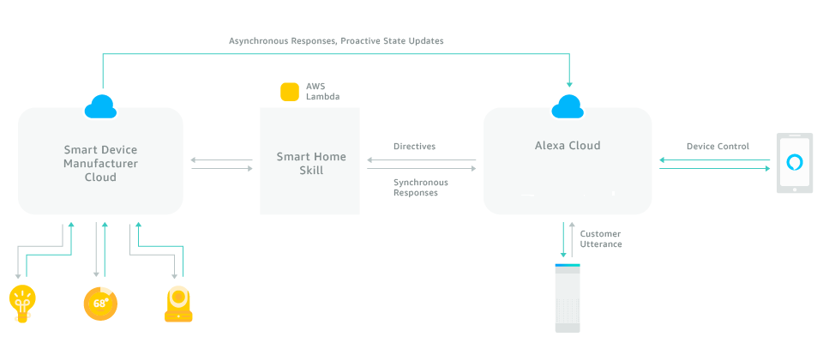
Alexa Smart Home Skill API - Summary

Slide 11
AVS Home Skill Semantics: Capabilities
Device functionality is modeled by specifying a set of standard capabilities.
Each capability has a specific interaction model and payload …really more like an “interface” than just a semantic category
Devices can support more than one capability
“Device clouds” can have more than one device…
There are also a set of standard capabilities to get/set properties
Many capabilities support both absolute and relative mechanisms to adjust properties
Many “actions” also report the current state

Slide 12
AVS Home Skill Capabilities: Targets
Capability | Description
PowerController | TurnOn or TurnOff a device (has associated powerState)
PowerLevelController | SetPowerLevel (absolute) or AdjustPowerLevel (relative) on a device. Has an associated powerLevel property that can be set to a valuel between 0 and 100
PercentageController | Generic interface similar to PowerLevelController or BrightnessLevelController, but used when “power” or “brightness” is not a valid description of the controlled property. Assumes a value between 0 and 100 in an “percentage” property. Can also be used to read sensors.
TemperatureSensor | No controls, just use ReportState/StateReport to query “temperature” property.
BrightnessController | SetBrightness (absolute) or AdjustBrightness (relative) on a light. Has an associated brightness property that can be set to a value between 0 and 100
ColorTemperatureController | SetColorTemperature (absolute) or DecreaseColorTemperature, IncreaseColorTemperature (relative, no value) on a device. Has an associated colorTemperature property that can be set to a temperature in Kelvin (voice interface understands color names, “warm”, “daylight”, etc).
ColorController | SetColor of a light using “color” whose type is a hue, saturation, brightness (HSB) triple. Note that mapping from this to RGB involves a matrix transform and a nonlinearity. Voice interface uses color names.

Slide 13
AVS Home Skill Capability: Additional Examples
Capability | Description
LockController | Lock or Unlock a lock device
ThermostatController | Supports thermostats with one, two, or three setpoints. Can also be queried to find the current temperature using a property and ReportState/StateReport. There is also a “mode” property: ECO, AUTO, COOL, HEAT, etc.
InputController | Select AV input to a TV using set of standard names (HDMI, etc)
ChannelController | Select Channel on a TV (both absolute and relative)
PlaybackController | Start and stop audio source
SceneController | Select a scene by name. Some limits on discovery based on device type.
Speaker | SetVolume, AdjustVolume, SetMute
StepSpeaker | AdjustVolume, SetMute (a subset of “Speaker” with no absolute volume, for when range of volume is not known).
CameraStreamController | Start and stop streaming video

Slide 14
AVS Home Skill Semantics: System Messages
Directives can also get or create messages with various types corresponding to “system capabilities”.
Capability | Description
Discovery | Every device: reports initial identification and capabilities
Authorization | AcceptGrant, provides bearer token, currently only OAuth2.0 supported
Response | Respond to directive - success
ErrorResponse | Respond to directive – error/failure, gives type of error, message for logging. Errors can include system issues (eg connectivity) but also payload issues (value out of range).
ReportState | Request state report
StateReport | Reply to state report
DeferredResponse | Used to indicate that will respond asynchronously to request (typ. >8s needed)
EndPointHealth | Check if physical endpoint can be reached from cloud shadow. Has associated Boolean property, “connectivity”

Slide 15
AVS Issues and Notes
“Device Cloud” (Shadow) must support HTTPS.
OAuth2.0 authentication must be supported.
Responses cannot take longer than 8s.
Live querying of the device status, if it takes longer than that, needs to use a shadow. The shadow state then needs to be proactively or asynchronously updated.
Actions that take longer than 8s to complete should use an asynchronous response to indicate completion.
Property status reporting
Not just the value, but also the timestamp, time uncertainty, and units
Optional features:
Status query, proactive status updates, scenes and scene discovery, streaming video and audio

Slide 16

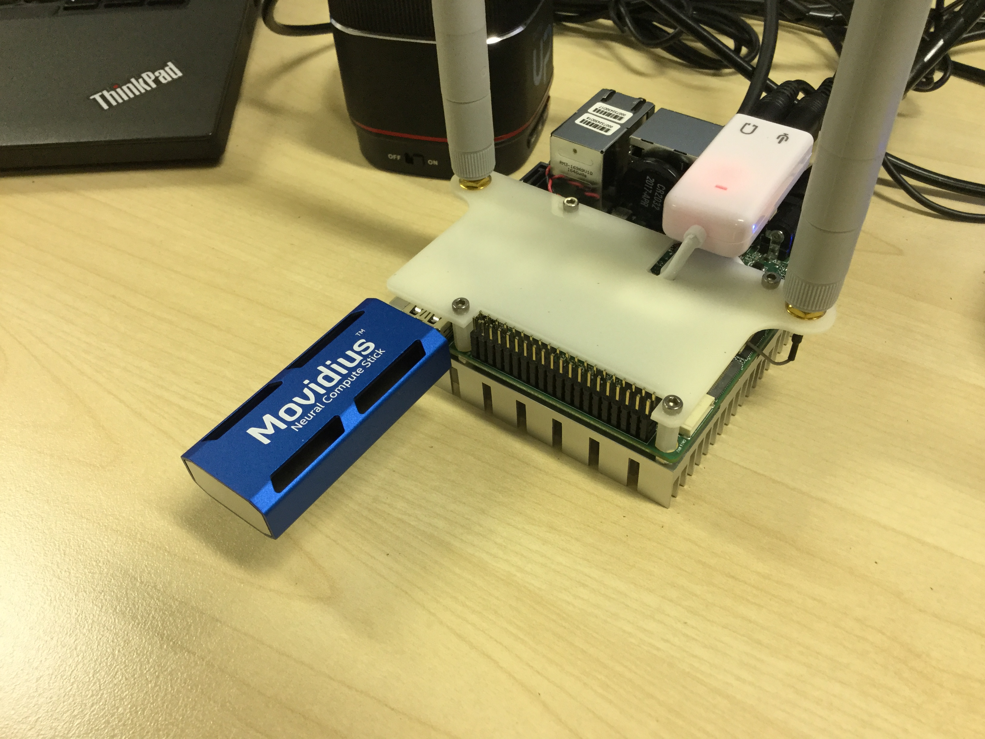
Fog Integration
Goal: Make services discoverable and locally available using WoT combined with fog capabilities.
Run WoT services on fog (OpenFog) software stack
Thing directory (WoT discovery)
Metadata bridges (eg to OCF)
Voice skill services (eg AVS)
Application servients (IoT services)
Connect to computational services
Recognition service (eg AlexNet)

Slide 17
TODO: Industrial POCs
Voice control is primarily a home use case
What do we want for industrial use cases?
What is different about industrial requirements?
Set of standards and their requirements are different
Real-time, pub-sub architectures, TSN, functional safety, central management, asset management, complex access controls, energy management…
Less emphasis on privacy, more on safety
Are municipal and building use cases more like home or industrial use cases?
What about automotive? Transportation? Retail? Medical?
They all have their own ecosystems…

Slide 18
TODO: Scenarios
Step through some specific scenarios
Voice Control for Consumer End Users
Service Composition for System Integrators
Compute Services (eg person recognition) for other Service Providers
Include not only home, but also industrial and municipal
Long tail – translation to older protocols
Adapt to different requirements, eg real time and functional safety
Need to talk to industrial users about requirements

Slide 19
Smart Security Scenario: Person Detection
This specific scenario can be demonstrated using OCF Smart Home capabilities, combined with one or more IP cameras. This application is of use in multiple verticals (home (eg security system), industrial (eg functional safety), municipal (eg subway track ingress).
Problem: Simple proximity detection systems, such as motion sensors, can be triggered by events other than human presence, leading to false alarms. However, constantly running AI-based human recognition is expensive.
Solution: Combine simple distributed motion sensors with AI-based person recognition. When a motion sensor is triggered, an image is captured in that location and sent to a person recognition service. Only if a person is detected is an alarm triggered. In addition, the AI service can be centralized so that only one recognition service is needed even if there are multiple cameras and motion sensors. As an extension, cameras could be mounted on mobile platforms (aka robots…).

